Slide 1
1st week of NLP project
Jakhongir Erkinov (100001943)
Joranas Cigas (100001693)
Chriswin Baiju (100001868)
David Ayad (100002565)

Slide 2


Books we selected
“War and Peace” (by Leo Tolstoy) “Anna Karenina” (by Leo Tolstoy)

Slide 3
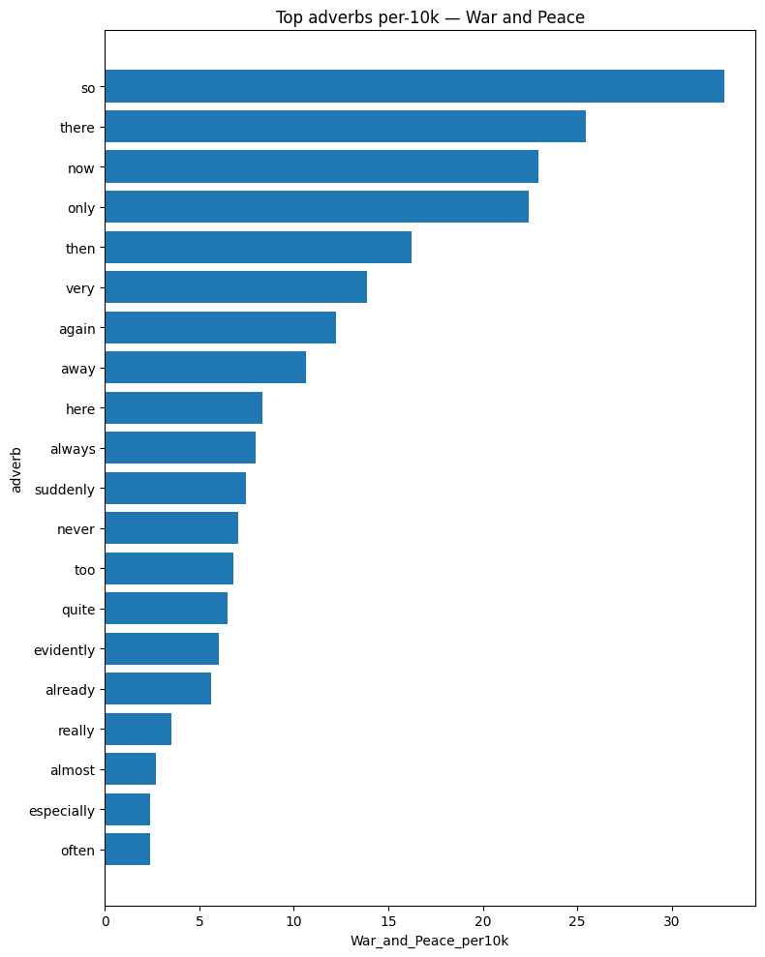
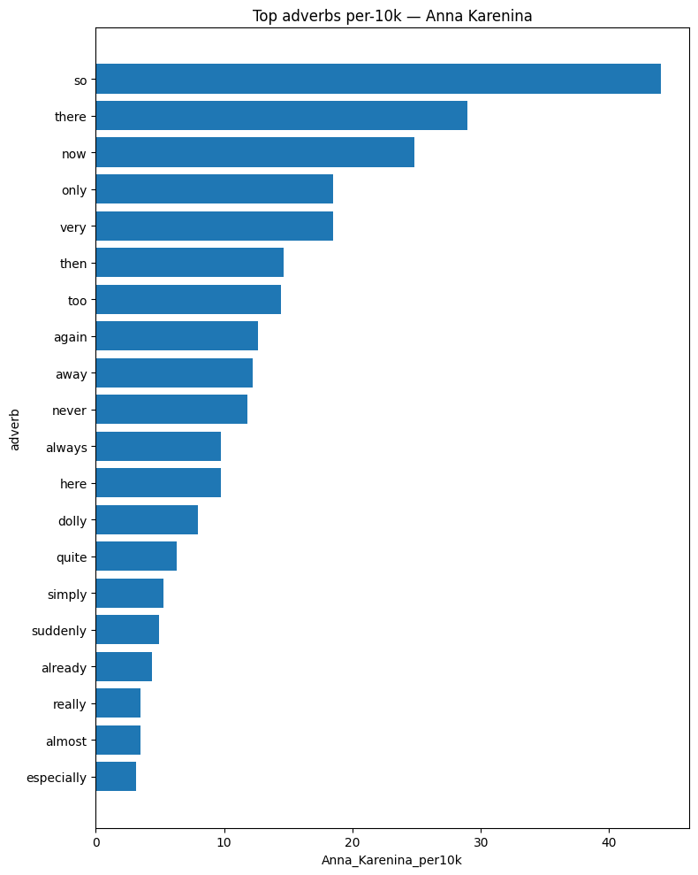
Adverbs

Slide 4
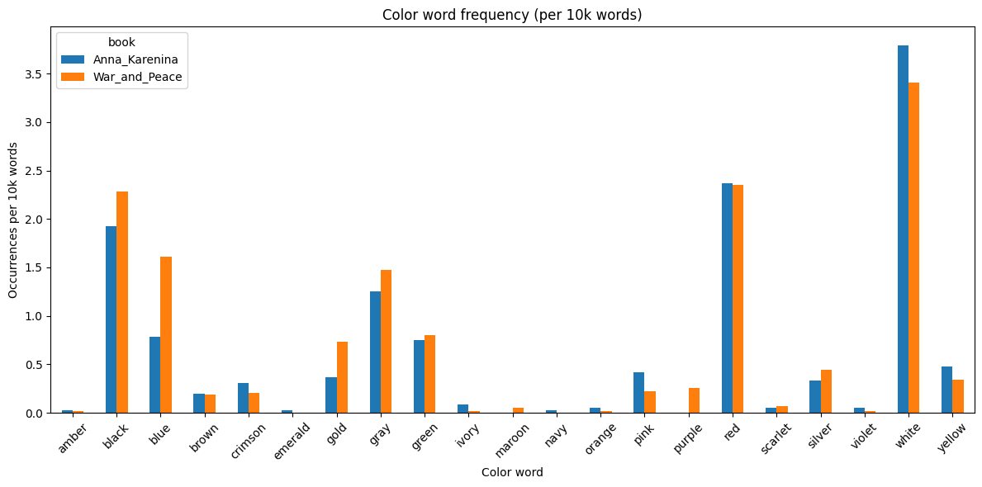
Color words

Slide 5
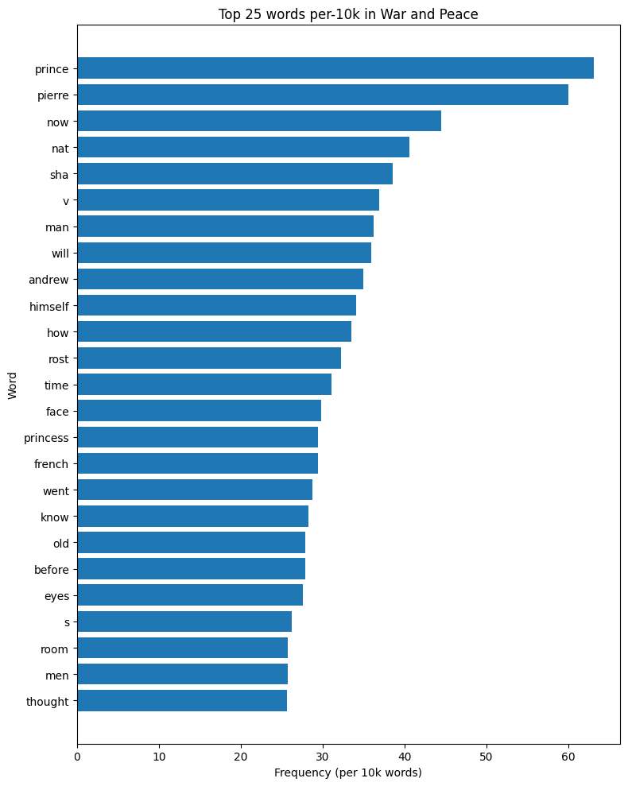
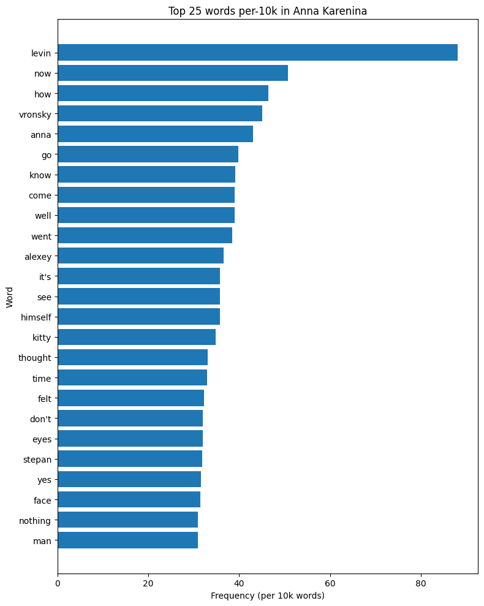
Frequent words

Slide 6
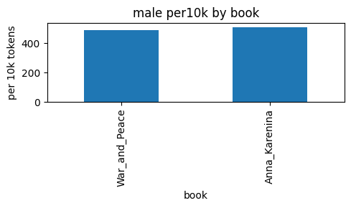
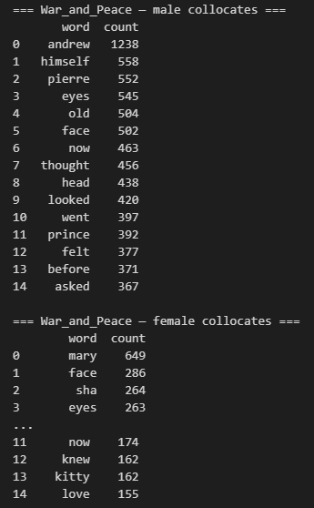
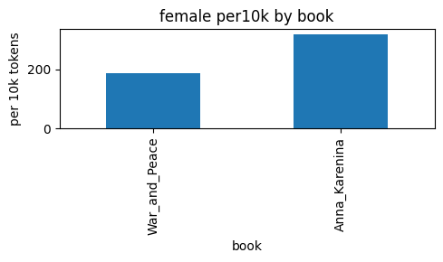
Gender language

Slide 7
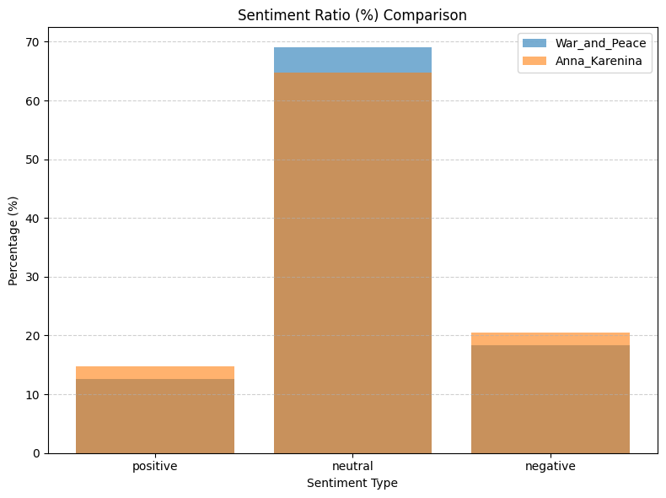

Sentiment analysis

Slide 8

Thank you for attention

